Slide 1
Salmon Population Statistics and Trends
United States Northwest
Predictive Model

Slide 2
Practical Takeaways
Not helpful to create an unsupervised model since each categorical variable has too many different variations, therefore linear regression was the best course of action in regard to the data.
This model can be used to anticipate the number of spawners coming into a region at a given time, meaning special preparations can be anticipated and made before the spawning season begins.
Conservationists can use this model to predict trends of salmon populations and create presentations for policymakers with the goal of protecting future salmon populations in the Northwest.

Slide 3
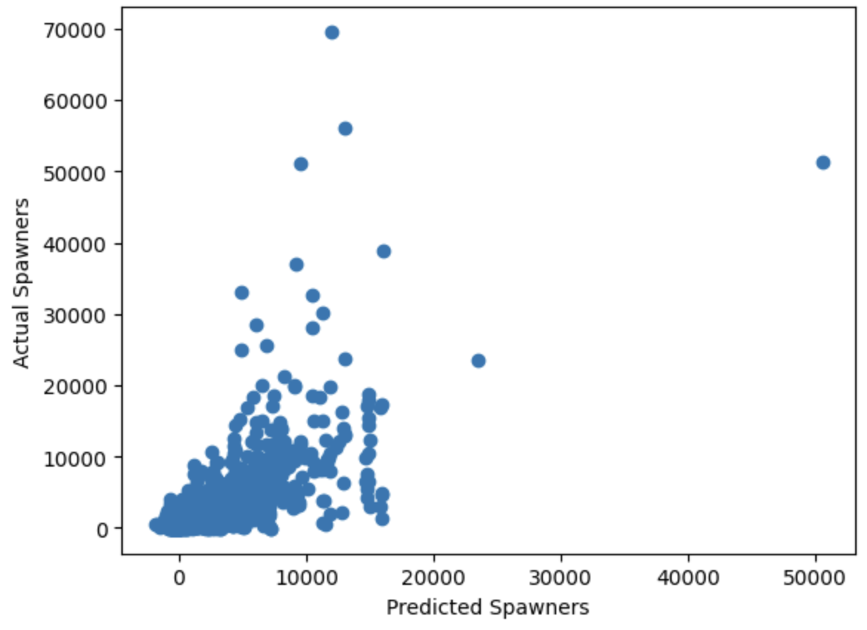
Actual vs Predicted Number of Spawners
Most of the data looks like it is predicted well, but some outliers exist where the model under predicts very high actual number of spawners.

Slide 4
Takeaways from the Model
Model explains approximately 50% of the data at a 30% test/train split.
R Squared Train: 0.533
R Squared Test: 0.491
RSME = 4,734.31 meaning the model has an average root error of 4,734.31 number of spawners, but notable outliers may be skewing this estimate.
MAE = 2,676.86 meaning the average absolute error is around 2,676.86. This means every prediction is, on average, plus or minus 2,676.86 compared to the actual number of spawners.
This model overall is decent at predicting the number of spawners but could be improved with more data (only 6,000 rows to create model).

